Slide 1
CUDA Programming
Lei Zhou, Yafeng Yin, Yanzhi Ren, Hong Man, Yingying Chen

Slide 2
Outline
GPU
CUDA Introduction
  What is CUDA
  CUDA Programming Model
  CUDA Library
  Advantages & Limitations
CUDA Programming
Future Work

Slide 3
GPU
GPUs are massively multithreaded many core chips
  Hundreds of scalar processors
  Tens of thousands of concurrent threads
  1 TFLOP peak performance
  Fine-grained data-parallel computation
Users across science & engineering disciplines are achieving tenfold and higher speedups on GPU

Slide 4
Outline
GPU
CUDA Introduction
  What is CUDA
  CUDA Programming Model
  CUDA Library
  Advantages & Limitations
CUDA Programming
Future Work

Slide 5
What is CUDA?
CUDA is the acronym for Compute Unified Device Architecture.
  A parallel computing ar chitecture developed by NVIDIA.
  The computing engine in GPU.
  CUDA can be accessible to software developers through industry standard programming languages.
CUDA gives developers access to the instruction set and memory of the parallel computation elements in GPUs.

Slide 6
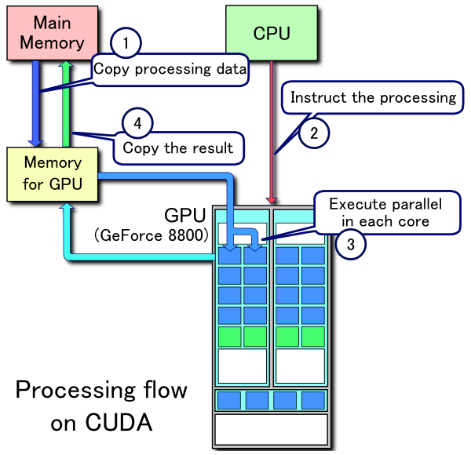
Processing Flow
Processing Flow of CUDA:
  Copy data from main mem to GPU mem.
  CPU instructs the process to GPU.
  GPU execute parallel in each core.
  Copy the result from GPU mem to main mem.

Slide 7
Outline
GPU
CUDA Introduction
  What is CUDA
  CUDA Programming Model
  CUDA Library
  Advantages & Limitations
CUDA Programming
Future Work

Slide 8
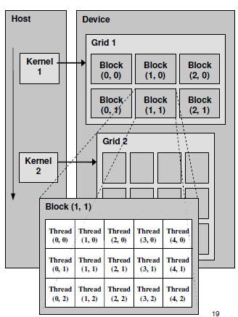
CUDA Programming Model
Definitions:
Device = GPU
Host = CPU
Kernel = function that runs on the device

Slide 9
CUDA Programming Model
A kernel is executed by a grid of thread blocks
A thread block is a batch of threads that can cooperate with each other by:
  Sharing data through shared memory
  Synchronizing their execution
Threads from different blocks cannot cooperate

Slide 10
CUDA Kernels and Threads
Parallel portions of an application are executed on the device as kernels
  One kernel is executed at a time
  Many threads execute each kernel
Differences between CUDA and CPU threads
  CUDA threads are extremely lightweight
    Very little creation overhead
    Instant switching
  CUDA uses 1000s of threads to achieve efficiency
    Multi-core CPUs can use only a few

Slide 11
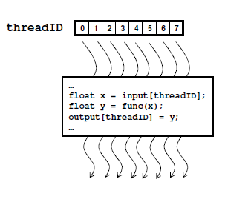
Arrays of Parallel Threads
A CUDA kernel is executed by an array of threads
  All threads run the same code
  Each thread has an ID that it uses to compute memory addresses and make control decisions

Slide 12
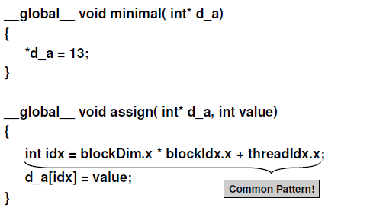
Minimal Kernels

Slide 13
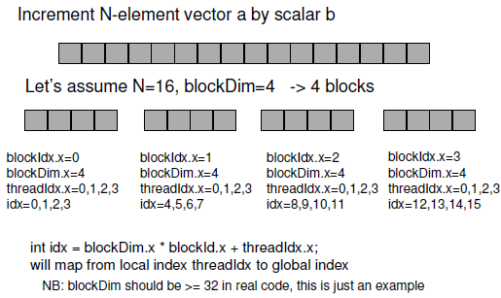
Example: Increment Array Elements

Slide 14
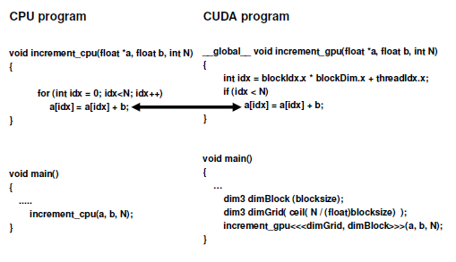
Example: Increment Array Elements

Slide 15
Thread Cooperation
The Missing Piece: threads may need to cooperate
Thread cooperation is valuable
  Share results to avoid redundant computation
  Share memory accesses
    Drastic bandwidth reduction
Thread cooperation is a powerful feature of CUDA

Slide 16
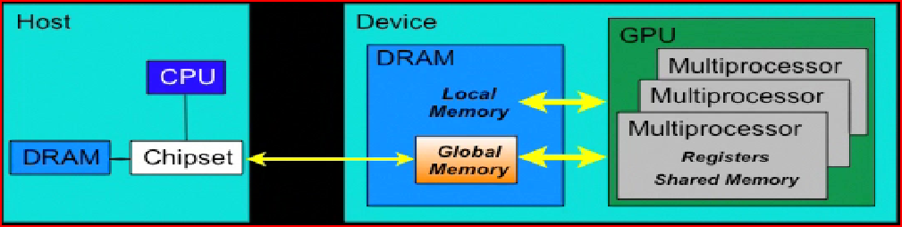
Manage memory

Slide 17
Outline
GPU
CUDA Introduction
  What is CUDA
  CUDA Programming Model
  CUDA Library
  Advantages & Limitations
CUDA Programming
Future Work

Slide 18
CUDA Library
The CUDA library consists of:
  A minimal set of extensions to the C language that allow the programmer to target portions of the source code for execution on the device;
  A runtime library split into:
    A host component that runs on the host;
    A device component that runs on the device and provides device-specific functions;
    A common component that provides built-in vector types and a subset of the C standard library that are supported in both host and device code;

Slide 19
CUDA Libraries
CUDA includes 2 widely used libraries
  CUBLAS: BLAS implementation
  CUFFT: FFT implementation

Slide 20
CUBLAS
Implementation of BLAS (Basic Linear Algebra Subprograms) on top of CUDA driver:
  It allows access to the computational resources of NVIDIA GPUs.
  The basic model of using the CUBLAS library is:
    Create matrix and vector objects in GPU memory space;
    Fill them with data;
    Call the CUBLAS functions;
    Upload the results from GPU memory space back to the host;

Slide 21
CUFFT
The Fast Fourier Transform (FFT) is a divide-and-conquer algorithm for efficiently computing discrete Fourier transform of complex or real-valued data sets.
CUFFT is the CUDA FFT library
  Provides a simple interface for computing parallel FFT on an NVIDIA GPU
  Allows users to leverage the floating-point power and parallelism of the GPU without having to develop a custom, GPU-based FFT implementation

Slide 22
Outline
GPU
CUDA Introduction
  What is CUDA
  CUDA Programming Model
  CUDA Library
  Advantages & Limitations
CUDA Programming
Future Work

Slide 23
Advantages of CUDA
CUDA has several advantages over traditional general purpose computation on GPUs:
  Scattered reads – code can read from arbitrary addresses in memory.
  Shared memory - CUDA exposes a fast shared memory region (16KB in size) that can be shared amongst threads.

Slide 24
Limitations of CUDA
CUDA has several limitations over traditional general purpose computation on GPUs:
  A single process must run spread across multiple disjoint memory spaces, unlike other C language runtime environments.
  The bus bandwidth and latency between the CPU and the GPU may be a bottleneck.
  CUDA-enabled GPUs are only available from NVIDIA.

Slide 25
Outline
GPU
CUDA Introduction
  What is CUDA
  CUDA Programming Model
  CUDA Library
  Advantages & Limitations
CUDA Programming
Future Work

Slide 26
Cuda Programming
Cuda Specifications
  Function Qualifiers
  CUDA Built-in Device Variables
  Variable Qualifiers
  Common Functions
Cuda Programming and Examples
  Compile procedure
  Examples

Slide 27
Function Qualifiers
_global__ : invoked from within host (CPU) code,
  cannot be called from device (GPU) code
  must return void
__device__ : called from other GPU functions,
  cannot be called from host (CPU) code
__host__ : can only be executed by CPU, called from host
__host__ and __device__ qualifiers can be combined
  Sample use: overloading operators
  Compiler will generate both CPU and GPU code

Slide 28
CUDA Built-in Device Variables
All __global__ and __device__ functions have
access to these automatically defined variables
dim3 gridDim;
  Dimensions of the grid in blocks (at most 2D)
dim3 blockDim;
  Dimensions of the block in threads
dim3 blockIdx;
  Block index within the grid
dim3 threadIdx;
  Thread index within the block

Slide 29
Variable Qualifiers (GPU code)
__device__
  Stored in device memory (large, high latency, no cache)
  Allocated with cudaMalloc (__device__ qualifier implied)
  Accessible by all threads
  Lifetime: application
__shared__
  Stored in on-chip shared memory (very low latency)
  Allocated by execution configuration or at compile time
  Accessible by all threads in the same thread block
  Lifetime: kernel execution
Unqualified variables:
  Scalars and built-in vector types are stored in registers
  Arrays of more than 4 elements stored in device memory

Slide 30

Common Functions

Slide 31
Cuda Programming
Kernels are C functions with some restrictions
  Can only access GPU memory
  Must have void return type
  No variable number of arguments (“varargs”)
  Not recursive
  No static variables
Function arguments automatically copied from CPUto GPU memory

Slide 32
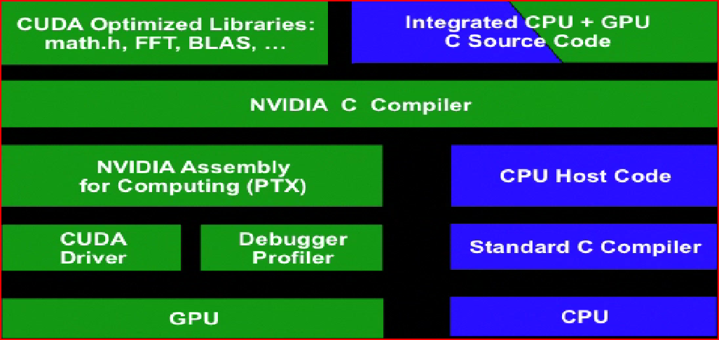
Cuda Compile

Slide 33
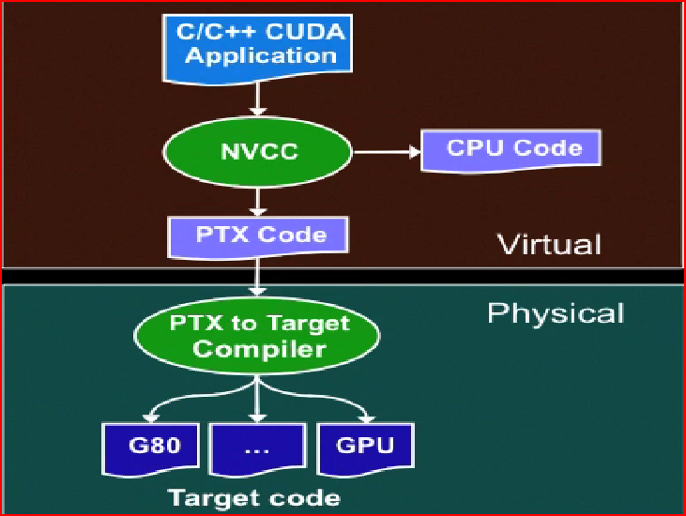
Cuda Compile_cont

Slide 34
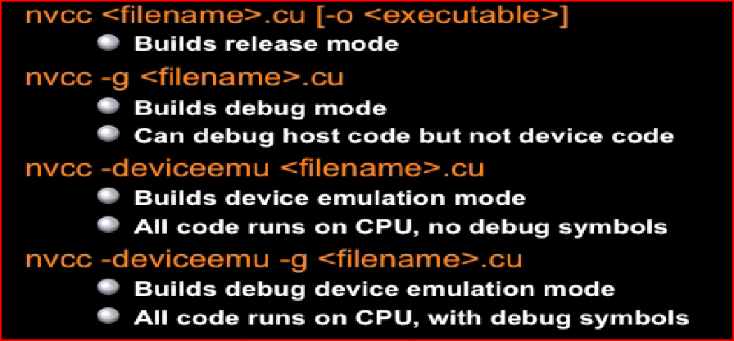
Cuda Compile_cont

Slide 35
Compile Cuda with VS2005
Method 1 – Install CUDA Build Rule for Visual Studio 2005
Method 2 – Manually Configure by Custom Build Event

Slide 36
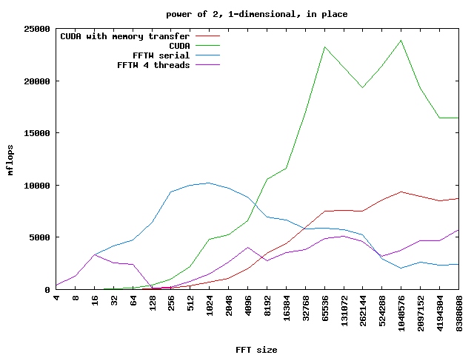
CUFFT Performance vs. FFTW
CUFFT starts to perform better than FFTW around data sizes of 8192 elements. It beats FFTW for most large sizes( > 10,000 elements)
Source: http://www.science.uwaterloo.ca/˜hmerz/CUDA_benchFFT/

Slide 37
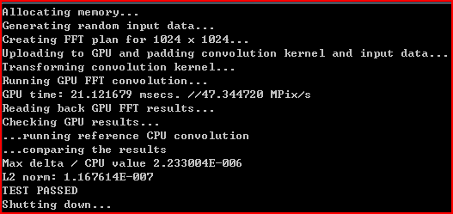
Convolution FFT 2D_ result

Slide 38
Future Work
Do optimization to code
    how to connect CUDA to the SSP re-hosting demo
    how to change the sequential executed codes in signal processing system to CUDA codes
    how to transfer the XML codes to CUDA codes to generate the CUDA input.

Slide 39
Reference
CUDA Zone http://www.nvidia.com/object/cuda_home_new.html
http://en.wikipedia.org/wiki/CUDA

